Slide 1
Samsung Innovation Campus
Artificial Intelligence Course
Notes:
Note:
1

Slide 2

Agenda
Intro
Pre-processing
MODEL
Design Thinking
API

Slide 3
Intro
About the project:
This project is about using x-ray chest to see if the person is
affected by covid-19 or not (normal).
How covid detects through x-ray:
Through the abnormal points which left in lungs, and the damage which may left on it too.
For more: X-rays and Covid
About the data:
The data size: almost 1.6 GB.
The data link: Kaggle_X_ray_Data.

Slide 4
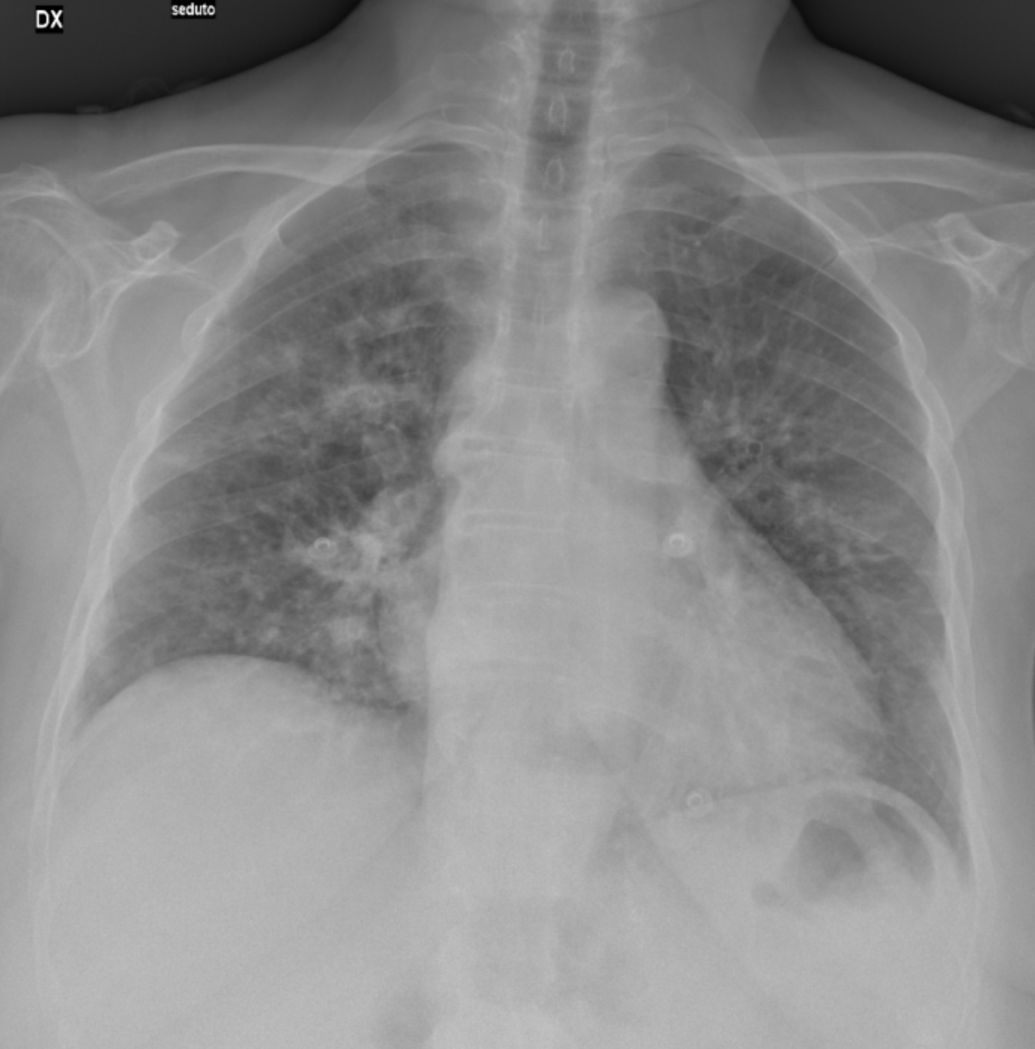
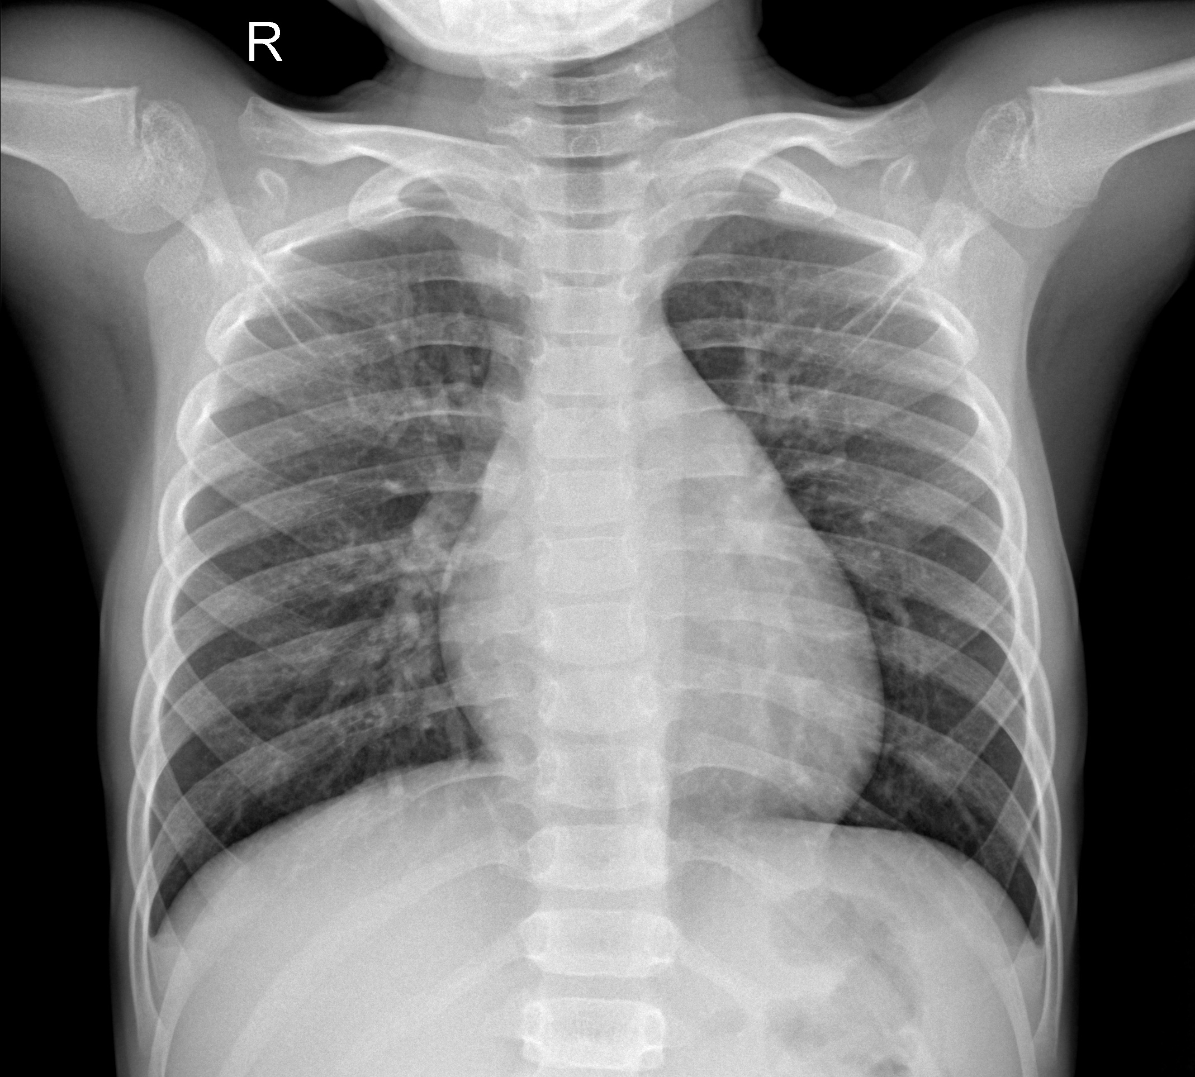
Covid
Normal

Slide 5
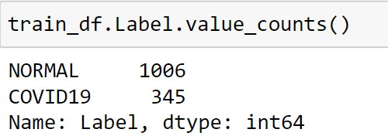
Pre-processing
We used the kears ImageDataGenerator after create the file paths and labels as a data frame.
We split the data to be .8 train and .2 test.
The data are im-balanced, most of the prediction are set to be normal even it’s really covid.

Slide 6
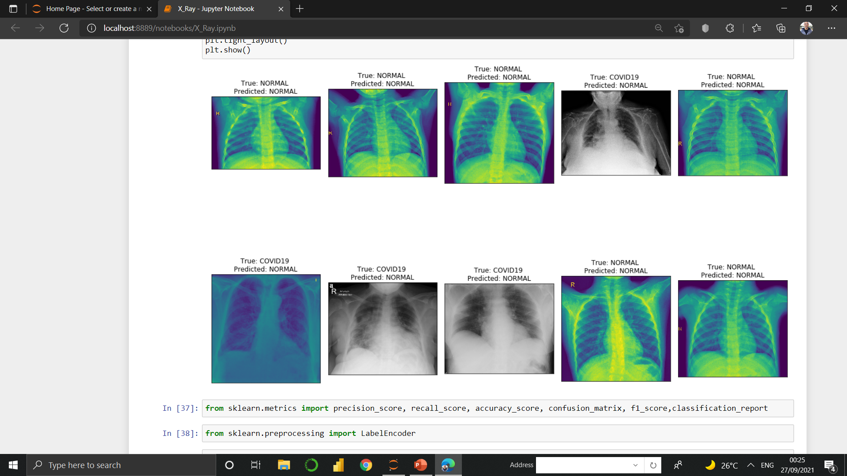
Im-Balanced prediction

Slide 7
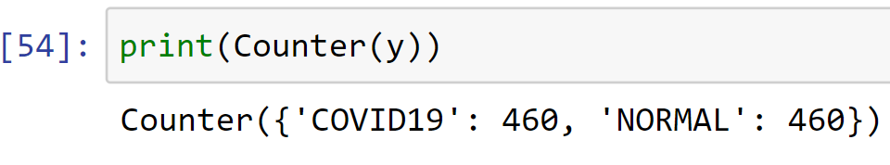
2.1 random sampling makes our life's betters.
We used the under random sampling(UMS) technique to fight the im-balanced data problem.
UMS chose number of records from the majority class which it’s the normal in this case and make it equals to the minority and it’s the covid class in this case.

Slide 8
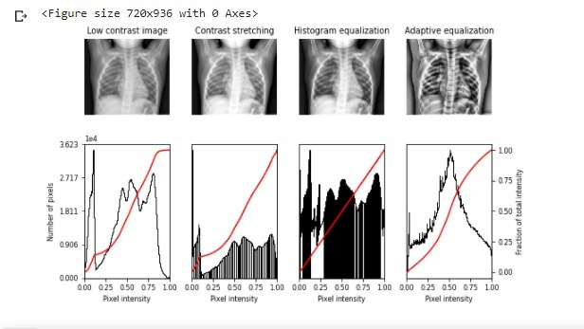
2.2 filters, filters, filters!
We try to apply the equalize histogram but, it occurs overfitting, and others get bad accuracy.

Slide 9
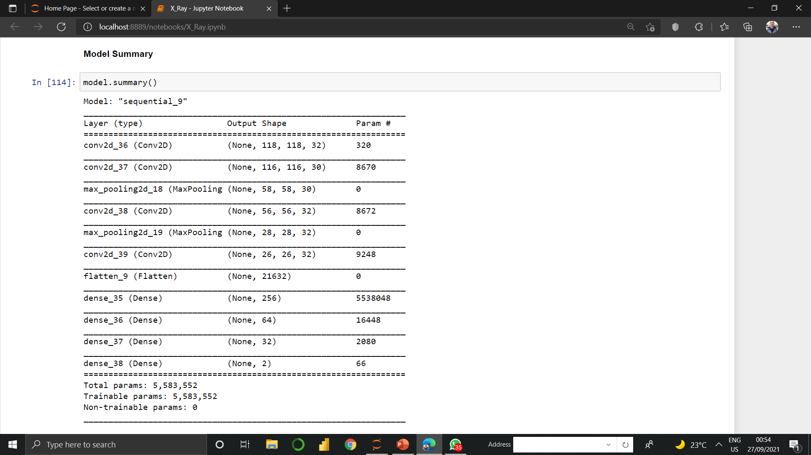
Model

Slide 10
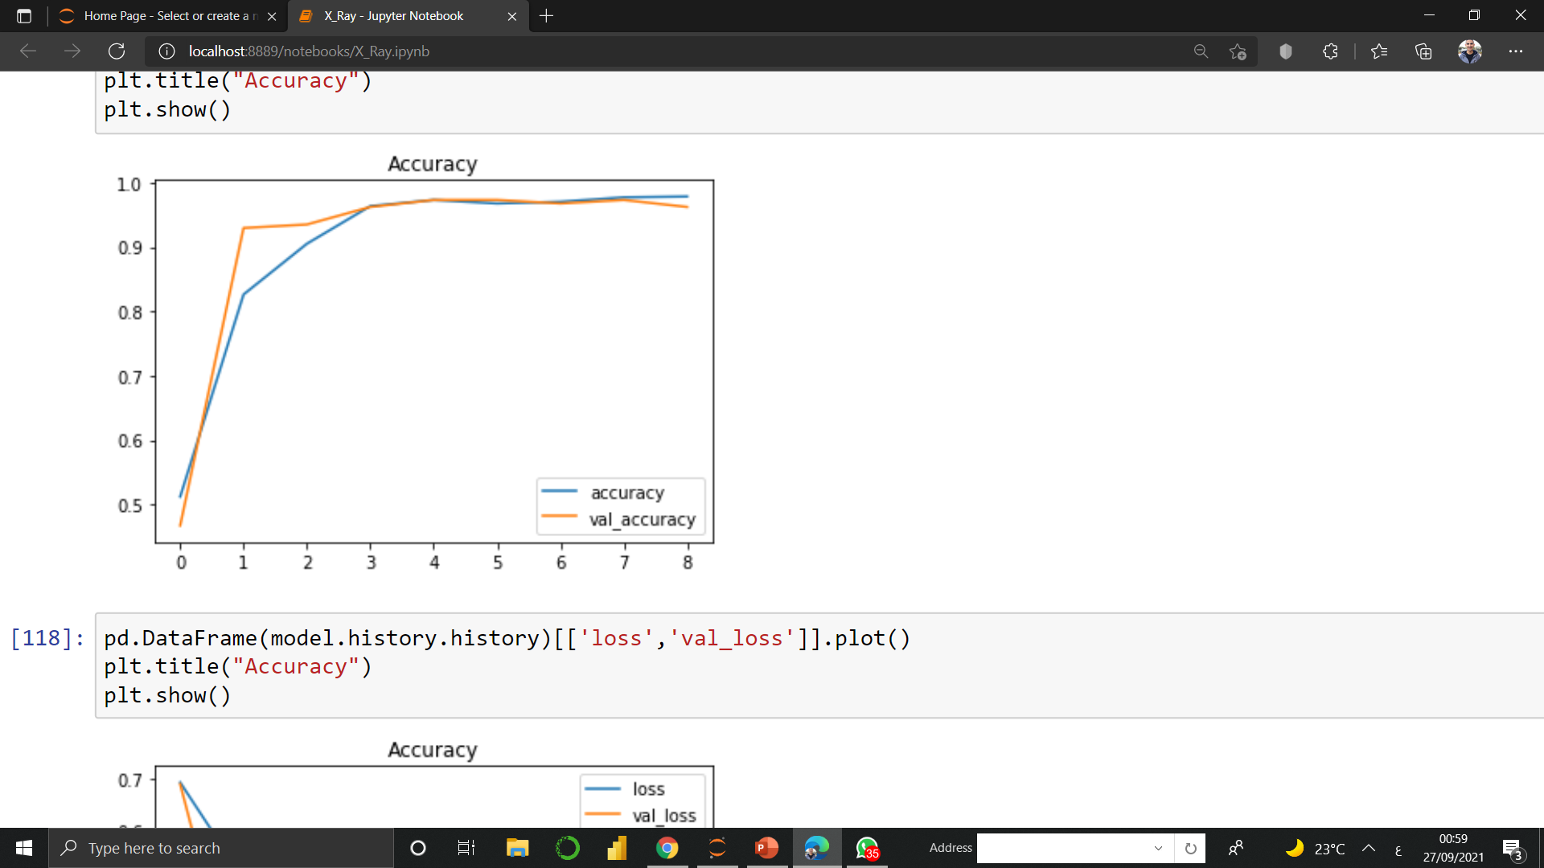
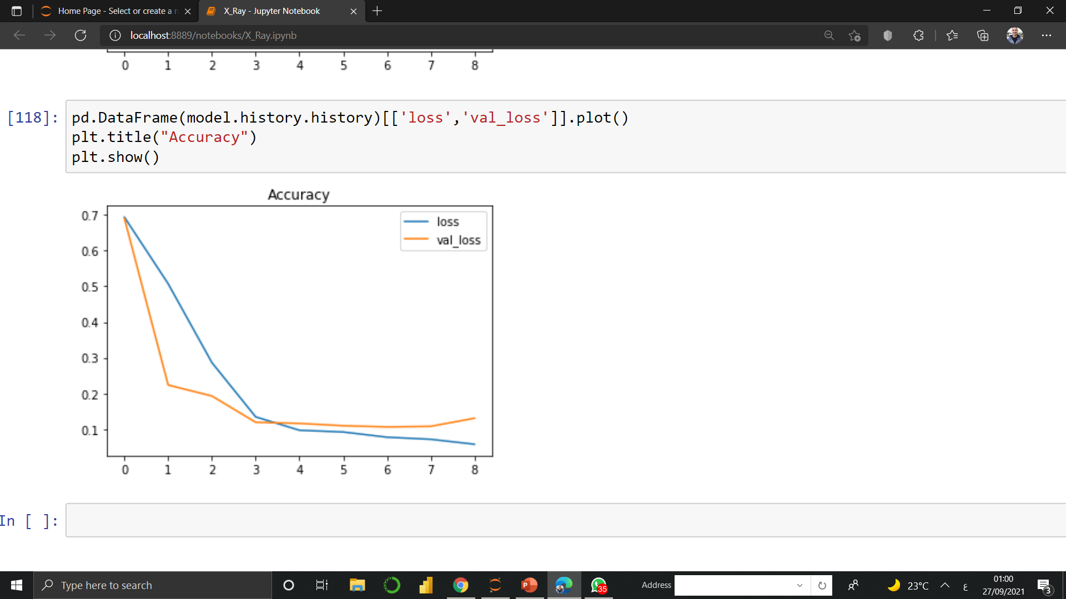

Slide 11
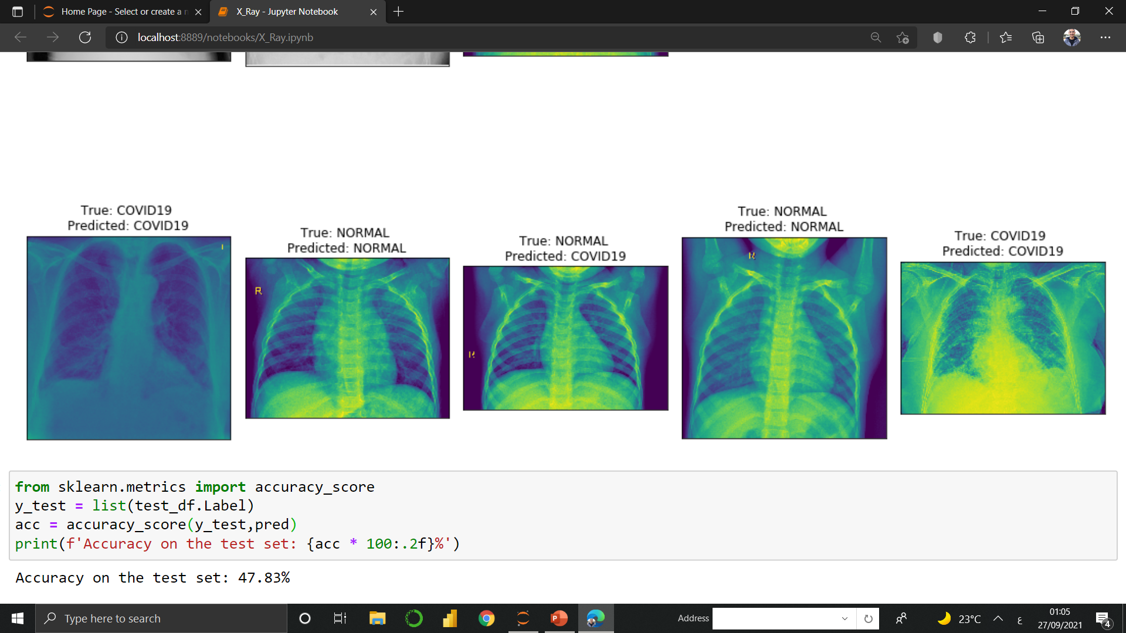
3.2 Prediction

Slide 12

Design thinking
Who would use this project?
This project will use the World Health Organizations and other competent authorities to find out if a person is infected with COVID19 or not, such as airports and hospitals.

Slide 13



What tools are needed?g
Design thinking
this model depends on lung shape in the image as tools used to predict so the first thank, we need chest x-ray.
we used data from Kaggle to build our model and some other software like visual studio & colab .

Slide 14
The promblem we are trying to solve :
Because the whole world is suffering from the pandemic of covid-19, so we are trying to solve this crisis, not in a small part.
Design thinking
The problems we are trying to solve the slow diagnosis of the virus, and the simple difference between an infected person and a healthy person.
Why this project ?

Slide 15
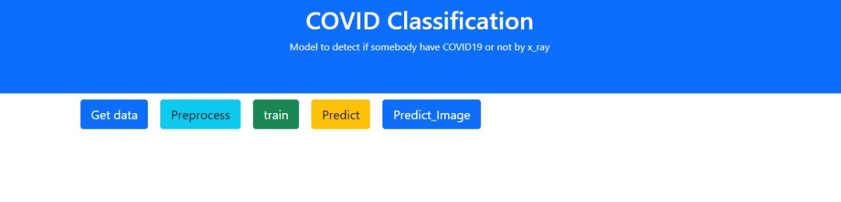
API
We use flask to create our API and let the program easier to use.
Main page

Slide 16
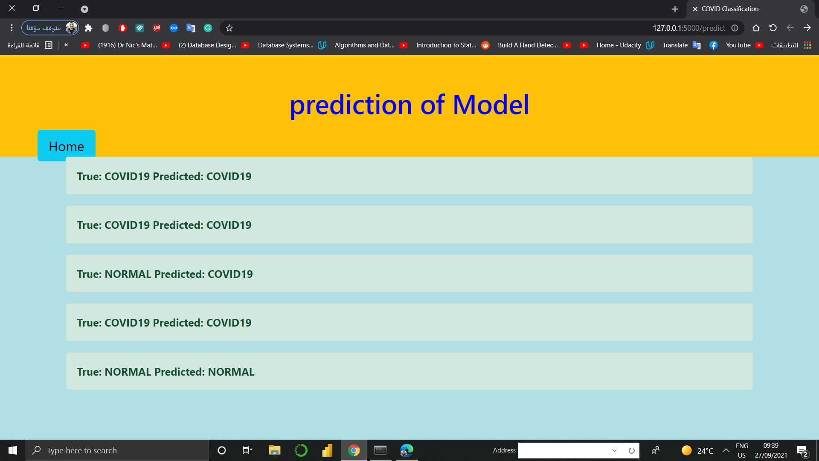
Prediction page

Slide 17
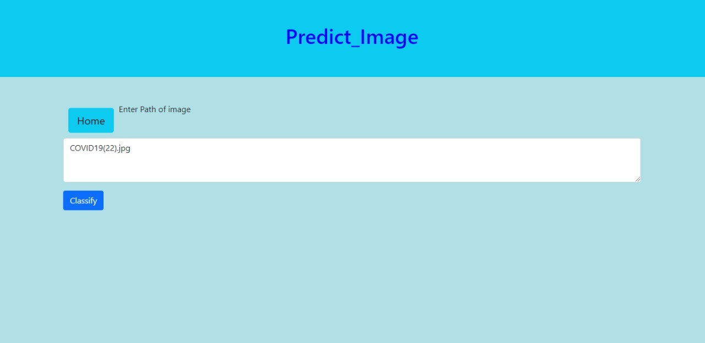
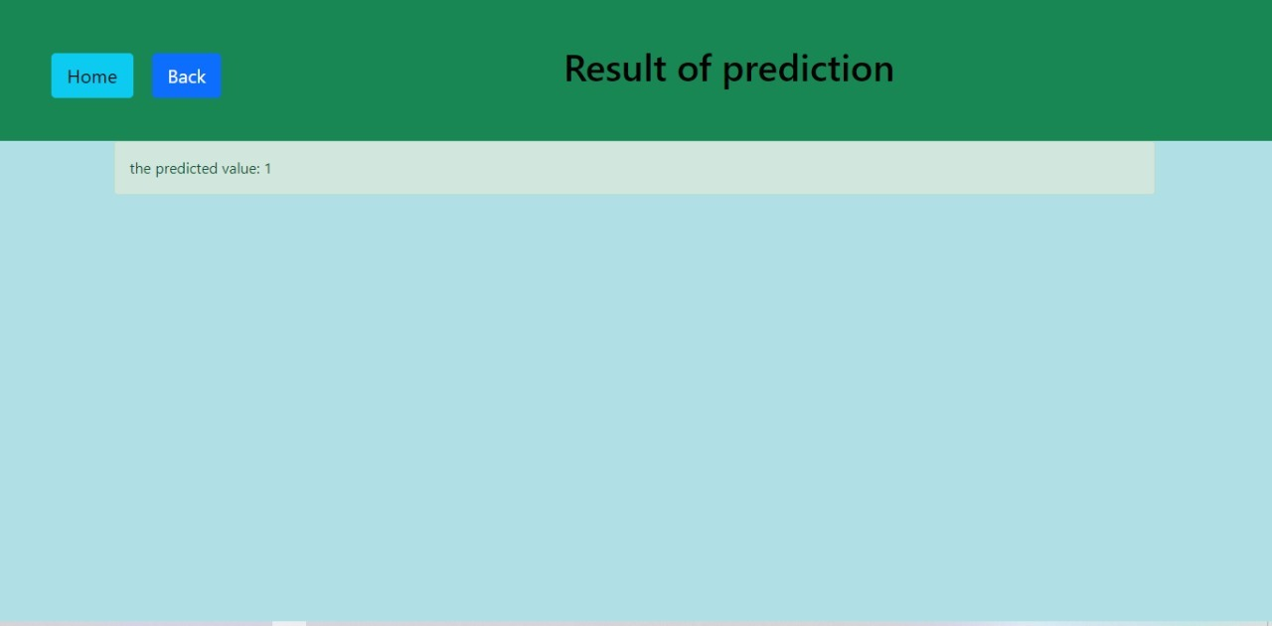
Predict-Path prediction
Predict image page
Path prediction page

Slide 18
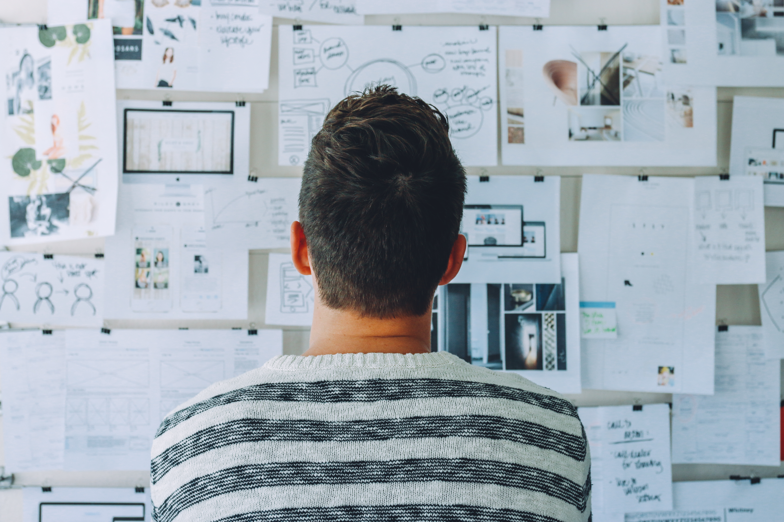
We are so glad for completing the discussion with you ,Dr. and we really appreciate all your efforts, a lot of thanks for you ,Sir.
.
Team
Abd El-Rahman Sabry Saber & Mohamed Abd El-Mohsen El-Srogy
Samsung Innovation Campus

